Slide 1
Best of Life
Creators: Doug Aquilino, Ibad Aslam, Bobby Frazette, Kevin Smart-Abbey, & Adam Zamojski

Slide 2

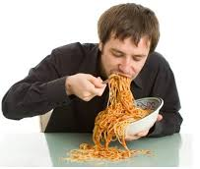
What was our motivation?
Have you ever been in a situation when you are with a group of friends who all want pizza, everyone has a different favorite pizzeria, and you just can’t choose which one is the best to order from? We felt that when everyone is “hangry” and indecisive, a tool to help choose the best would be an excellent tool.
From
To
Quicker!

Slide 3

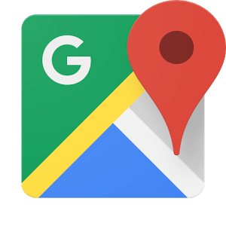

What is “best of life”?
You!

Slide 4
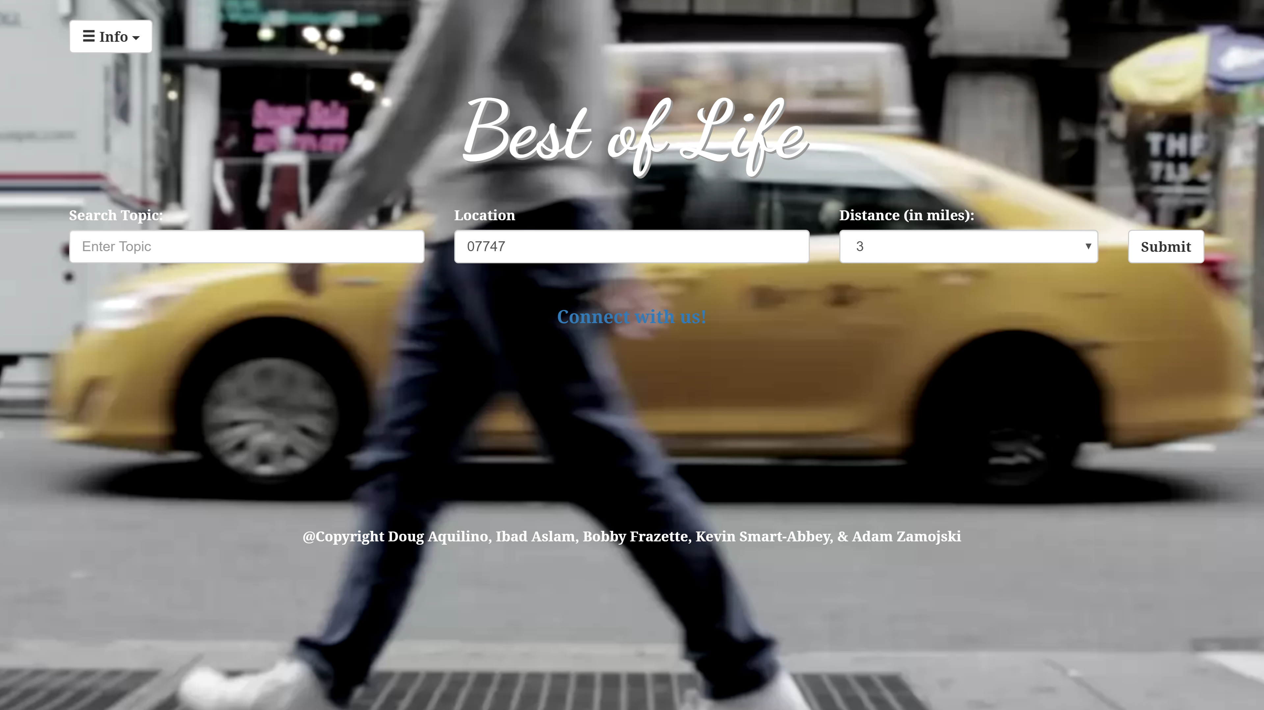
What is “best of life”?
The Best of Life is a tool that anyone can use to find the “best of” something within a certain distance from a certain location

Slide 5
How does “best of life” work?
The user will type in what they are looking to find the best of into the search bar.
They will then enter in their location and what radius they want to search within.
After the user clicks the search button, Best of Life uses the power of Yelp to find the searched businesses and sorts them by best rating. Then Best of Life uses the power of Google Maps takes the location data of the best locations and displays them on a map.
At this point the user can click on either a gold, silver, or bronze ribbon (gold being the best) and they can see more information about that business including a link to their page on Yelp.

Slide 6
What technology did we implement?
Technology in the program itself:
HTML, CSS, Bootstrap, Google Fonts, JavaScript, Jquery, 2 APIs, AJAX, PHP, Coverr
Technology used to help create the program:
Heroku, GitHub, Sublime, Trello, PowerPoint
APIs used
Google Maps
Yelp

Slide 7
What problems did we experience?
Yelp API
CORS (cross origin resource sharing)
Google Maps API
JavaScript bugs
CSS bugs

Slide 8
Questions???

